Slide 1


Indy Apple Pay Implementation

Slide 2


Agenda
1
Apple Pay Overview
2
Apple Pay Testing Highlights
3
Apple Pay Test Strategy
4
Apple Pay Work flow
5
Technical Work flow
6
Functional Testing
7
Apple Pay Metrics

Slide 3
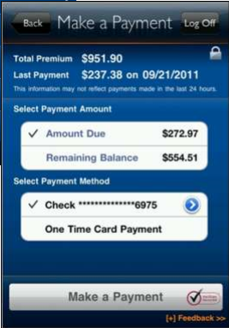
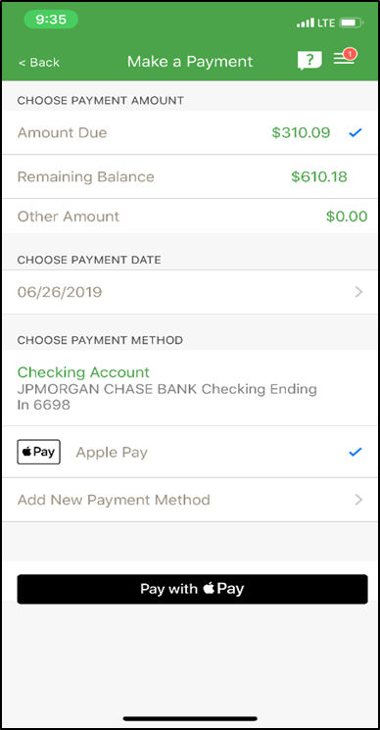
Apple Pay Overview
Objective:
The purpose of this project is to implement Apple Pay for making payment transactions on Sales and Service. The option for Apple Pay will be presented as a payment method on the Make a Payment page.
Business:
Auto / Cycle Sales
Auto / Cycle Services
Features Implemented :
Scheduled future dated Payments
Immediate Payment
Adding Card to Apple Wallet
Payment page without Apple Pay
Payment with Apple Pay

Slide 4
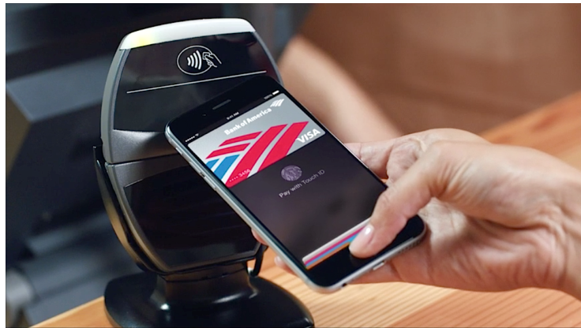
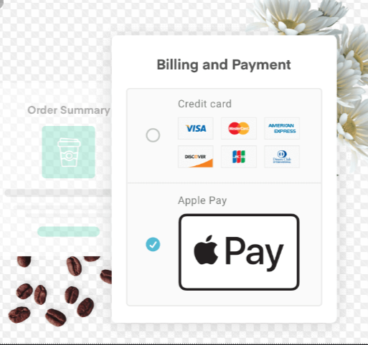
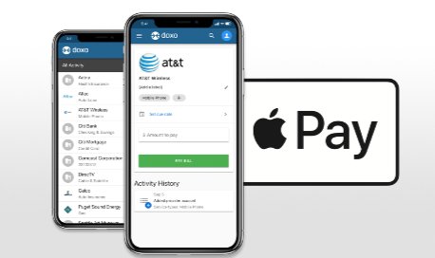
Indy QA Testing Highlights of Apple Pay Testing
The following Apple Pay mobile web services are tested by Indy team.
Apple Pay payment
Card Authorization
Apple Pay Extraction (Makes a scheduled future payment on a policy using Apple Pay)
Apple Pay Sales
Payment Search
Apple Pay Wallet
Created 100% Automation Testing in place for Smoke, Functional, Regression & Performance
The following enhancements are done to the API Framework by Indy QA team to achieve 100% automation
Include the response XML and html report as part of service results
Capture parameter values from services to integrate the test cases for end to end automation
Include test case IDs in HTML report for better troubleshooting the issues
Enhanced the results dashboard for better readability
Designed the performance Scripts through VUGEN
Gained knowledge on Apple Pay functionality including BEAM BBS Layer, Settlement process, Duck creek Billing
Tools Used – API Runner, Postman, VU Gen, Splunk & TDM
Apple Pay Channels
POS
WEB
INDY SCOPE
MOBILE
Notes:
For July 20th Release, focus is on Service customers utilizing the Mobile App/Website to make a premium payment on an existing Duck Creek policy and Sales endpoint during the August Release.

Slide 5

Apple Pay Test Strategy
Encrypted Bundle
Decryption Process
DPAN , ECI , Cryptogram is send to DC for payment processing
BBS Service authorization card
Paymentech Callout
Payment processing
Payment Settlement
Apple Pay sends Encrypted
Bundle to BBS Layer
Orbital Gateway decrypts the bundle
BBS service authorizes the card
Payment is processed on successful Paymentech callout
Payment settlement process starts after successful payment
Encrypted payment token, encapsulates the information needed to complete a payment transaction, including the device-specific account number (DPAN), the amount, and a unique, one-time-use cryptogram.
Decryption Failure Validation : Error message validation when invalid bundle is passed to orbital gateway through Web services . (QA adds special characters like $, # % to bundle)
Authorization exception handling : Testing is done by providing invalid public hash key , Invalid Transaction Id , Invalid Signature and Invalid Cryptogram. (QA adds special characters like $, # % to make parameters invalid , Provide wrong Payment type )
Successful payment processing and error messaging validation.
QA validates error messages like Service down , duplicate payments , amount more than due etc.
Settlement service is validated in Splunk or DB and QA validates if money is deposited in GEICO account.
QA validates Mobile Payment history service to verify the payments history.
Apple’s tokenized version of the customer’s card, as well as a cryptogram and ECI indicator will be passed to the Paymentech Orbital Gateway to unencrypt and authorize payment.
QA Touchpoints
Indy QA
External Systems for Apple Pay Services

Slide 6

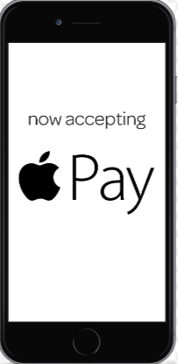
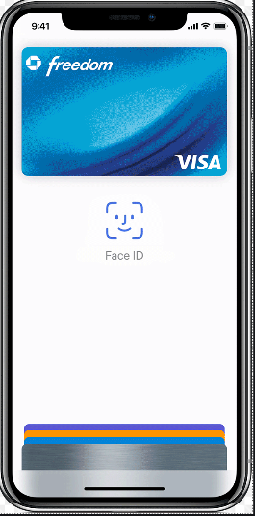
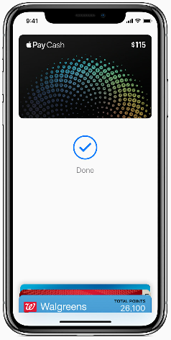
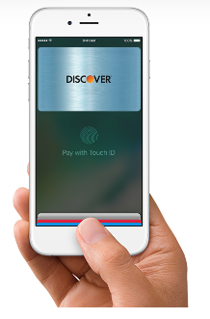



Apple Pay Work Flow
Customer & Payment Information
Decrypt
Select Apple Pay Payment method
Payment
Payment Confirmed
Payment Provider
Pay with Touch Id / Face Id
Valid Touch / Face Id
Create Cryptogram Encrypt Customer Information

Slide 7
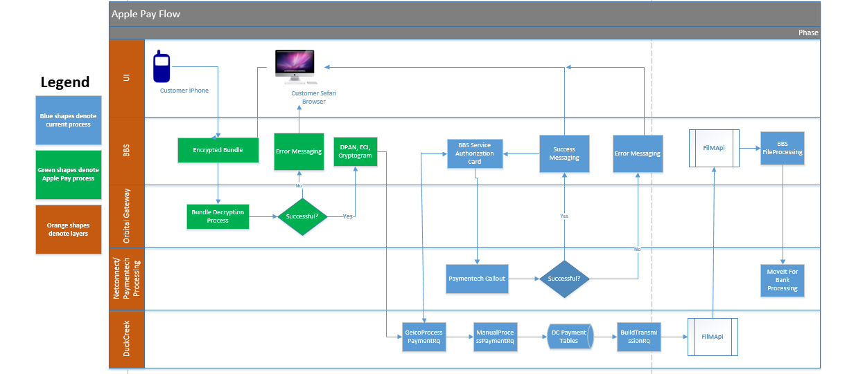
Technical Flow
When customer selects option on the payment page titled as “Apple Pay”, a pop-up window will display the payment information including the amount to validate the amount.
To make a payment user will be prompted to scan their finger or face depends on iPhone device/model.
Once authorization is successful, a payment “bundle” is created and passed from the Mobile app to BEAM
Bundle contains two portions
Unencrypted portion contains information such as the vender (MC, Visa, AmEx, Discover), card type (credit/debit) and billing contact info (zip).
Other part is Encrypted portion, unencrypted payload will contain DPAN, which is Apple’s tokenized version of the customer’s card, as well as a cryptogram and ECI indicator which will be passed to the Paymentech Orbital Gateway to unencrypt and authorize payment.

Slide 8
Functional Testing : Sample Service
Service: Apple Pay Payment
Makes a payment on a policy using Apple Pay
Endpoint URL: https://billingbbs-ut1.geico.net/billingbusinessservice/policy/{policyId}/applepaypayment
Verb: POST
URI Parameters:
Sample Request:
{
"Bundle": {
"PaymentMethod": {
"PaymentMethodDetails": "sample string 1",
"PaymentMethodNetwork": "sample string 2",
"PaymentMethodType": "sample string 3"
},
"BillingContact": {
"AccountName": "Alex",
"PostalCode": "sample string 1"
},
"PaymentData": "sample string 1"
}
}
Name | Description | Type
policyId | The policy ID the payment is being made against | string
Parameter | Description
PaymentMethodDetails | The payment method with Card last 4 digits
PaymentMethodNetwork | AmEx, Discover, Master Card or Visa
PaymentMethodType | Credit or Debit
billingContact | The billing contact details
accountName | The account holder name
postalCode | The postal code
paymentData: | Apple pay bundle

Slide 9
Apple Pay Production Metrics
Apple Pay transactions by day
We see a steady increase since the release of daily Apple Pay transactions.
A promotion via the Message Center for Apple Pay was published on August 1st.
Apple Pay transactions from 7/20 to 9/13
Apple Pay Production data
 | Captured Transactions | Authorized Transactions
Payments | 1932 | 100
Amount | $399,234.21 | $21,112.42

Slide 10

THANK YOU!
Email: solutions@valuemomentum.com
ASIA PACIFIC
Plot No 36 & 37, Gachibowli,
Financial District, Nanakramguda
Hyderabad- 500032, India
Tel: +91 40 66509300
US HEADQUARTERS
220 Old New Brunswick Road
Piscataway
NJ 08854
Tel: (908) 755 0048

